Slide 1
Parsing I : Introduction
Lecture 6
CS 4318/5331 Spring 2010
Apan Qasem
Texas State University
*some slides adopted from Cooper and Torczon

Slide 2
Review : Lexical Analysis
First phase in the compilation process
  Scans the source code and generates a stream of tokens for the parser
Three tasks
  Specify token patterns
    Regular Expressions
  Recognize tokens in the input stream
    Deterministic Finite Automata (DFA)
  Reporting Errors
    Not too many
    Illegal Token
    Unterminated Comment
    Unterminated Strings Constants

Slide 3
Review : Lexical Analysis
Important theoretical results
  Equivalence of REs and DFAs
  Equivalence of NFAs and DFAs
Algorithms
  RE to NFA : Thompson’s Construction
  NFA to DFA : Subset Construction
  DFA to Minimal DFA : Hopcroft’s Algorithm
  Correctness and complexity
Automatic Scanner Generator
  lex, flex

Slide 4
Review : Lexical Analysis
Theory
  Formal language
  Automata
Algorithms
  Fixed point computation
  Worklist algorithms
Mathematics
  Set theory

Slide 5
Parsing
Source
Scanner
tokens
Parser
IR
code
Errors
Input : stream of tokens and a grammar
Output : intermediate representation
Natural language analogy
  Check the stream of words and their parts of speech (produced by the scanner) for grammatical correctness
Similarities with the scanning phase
  Grounded on mathematical foundations
  Direct application to automatic parser generators

Slide 6
What The Parser Needs To Do
A parser’s primary responsibility is detecting syntax
errors in the input program
  many more syntax errors than lexical errors
    Examples?
  some lexical errors may only be caught at this stage
    myVar -> myvar

Slide 7
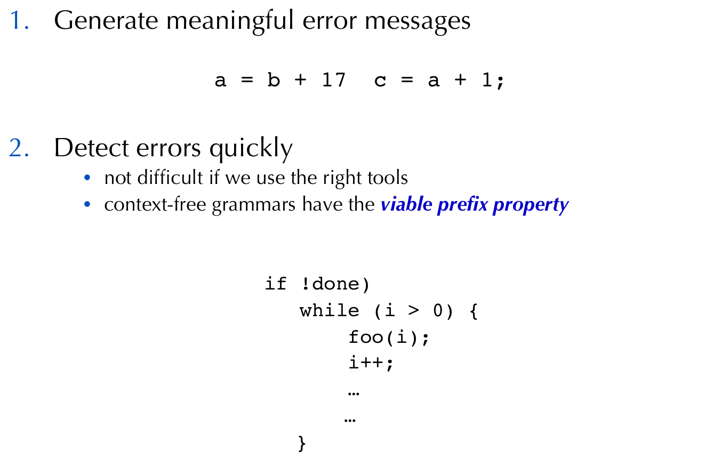
What The Parser Needs To Do

Slide 8
What The Parser Needs To Do
Recover from errors
    quit after the first error is detected?
    recovering gracefully can be difficult
      “too many errors” message
    language does not mention anything about error recovery
Require minimal overhead in processing correct programs
  Why is this important?

Slide 9
What The Parser Needs To Do
Create an intermediate representation for later phases
    IR should be easy to work with and capture the necessary information
    Second layer of abstraction on the program
Maintain symbol table
  help semantic analysis
    type checking
May also insert code to detect runtime errors
  Division by zero

Slide 10
Next Two Weeks
Grammar and derivations
  Context-free grammar
Top-down Parsing
  Hand coded recursive descent parsers
Bottom-up Parsing
  Automatic LR(1) parsers
Write a parser using yacc for mC

Slide 11
Specifying Syntax
For the parser to detect syntactic errors we need a set of rules that describes the syntax of the language
Lets try to describe one for C

Slide 12
Specifying Syntax
Every statement must be immediately followed by a ‘;’
What is a statement?
  A statement is something that has an LHS and an RHS with a ‘=‘ symbol in the middle
What is an LHS?
  An LHS is a variable
What is a variable?
  A variable is an identifier
What is an RHS?
  An RHS is an expression
What is an expression?
  An expression is something that has operators, variables, constants, ….

Slide 13
Specifying Syntax
To specify the syntax of a programming language we will need a whole bunch of rules
Ad-hoc rules will not work that well, need formalism
Many of the rules will need to be of the form
  A is defined in terms of B
  or
  A can be derived from B
A set of rules that formally describe the syntax of a language is commonly referred to as the grammar for that language
A grammar mathematically defines the strings of symbols that form syntactically valid sentences in the language
  A sentence in this context is our input program
The type of grammar used to describe the syntax of programming languages is called a context-free grammar or (CFG)

Slide 14
Regular Expressions Expressibility
Can we use regular expressions to …
  Describe the natural language?
    No
  Specify the syntax of a programming language?
    Almost
  Describe the language of all strings with
    2 a’s followed by 2 b’s
      Yes, (a+b)*aabb(a+b)*
    17 a’s followed by 17 b’s
      Yes, (a+b)*aaaaaaaaaaaaaaaaabbbbbbbbbbbbbbbbb(a+b)*
    equal number of a’s and b’s?
    No!
    {a^{n}b^{n} | n >= 1}
We can’t count with REs!
(when we don’t know how much we have to count to beforehand)

Slide 15
Regular Expressions Expressibility
What common programming language constructs cannot be expressed by REs?
  matching brackets
  pairs of keywords
We used a ‘hack’ for comments and strings in the scanning phase
Cannot use that strategy if we have nested brackets
  Amounts to keeping count of open brackets
  ( … ( …. ( …. ( )…. …) … ) … )

Slide 16
Regular Expressions Expressibility
Expressibility is just one of the reasons for not using REs to describe syntax
Other considerations
  Efficiency
  Simplicity
  Error detection
We will look at these, more practical reasons later

Slide 17
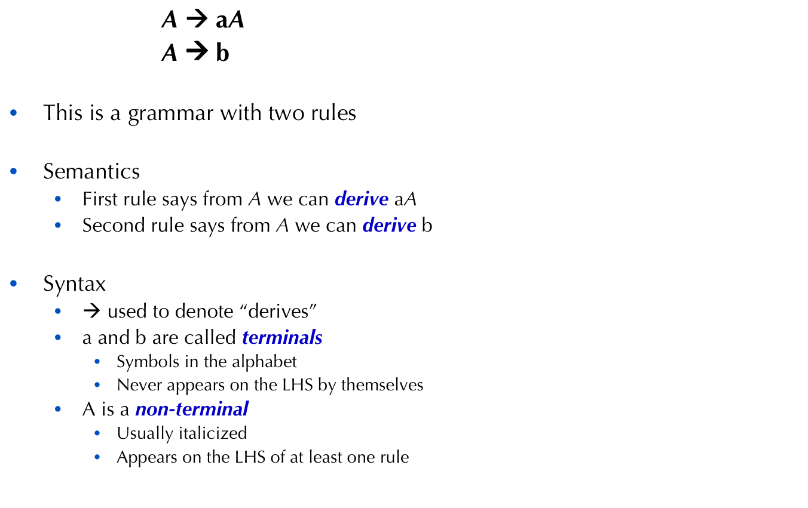
Notation for Grammar

Slide 18
Notation for Grammar
        <A> ::= a<A>
        <A> ::= b
        A → aA
        A → b
        A → aA
        | b
        A → aA | b
Backus-Naur form (BNF)
Variation on BNF
Stroustrup uses another variant in his book!
The C++ Programming Language, Appendix A

Slide 19
Grammar Definition
Formally, a grammar is a four tuple, G = (S,N,T,P)
    S is the start symbol
    N is a set of non-terminal symbols
    T is a set of terminal symbols
    P is a set of productions rules
The language described by G is denoted L(G)
  All strings in L(G) can be derived from S following a sequence of zero or more production rules
  Any string derived from G must be in L(G)

Slide 20
Grammar Classification
Grammars can be classified based on the types of rules that are allowed in P
  regular
    each production in P has the form
    NT → TNT or NT → T.
  context-free
    each production in P is of the form
  NT → (N U T)*
  context sensitive
    each production in P is of the form
  (N U T)* → (N U T)*
    where | LHS | <= | RHS |
  unrestricted
    each production in P is of the form
  (N U T)* → (N U T)*
    where LHS is not empty

Slide 21
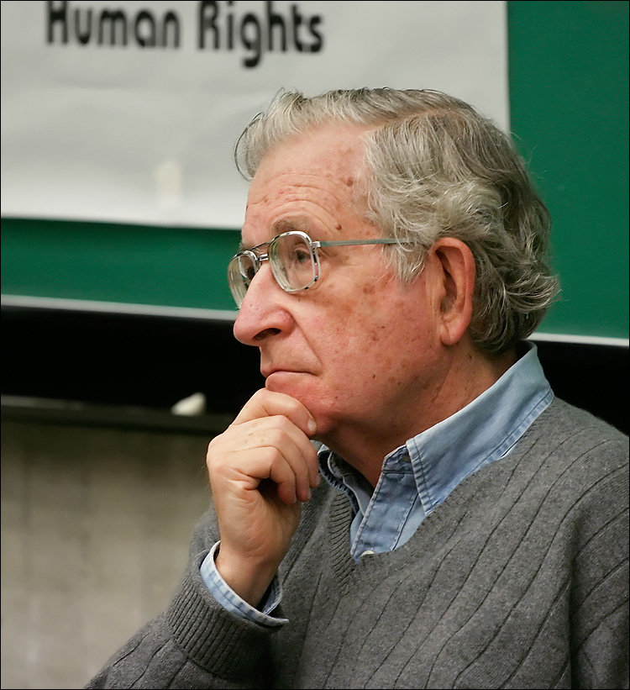
Chomsky Hierarchy
DFA/NFA
RL
PDA
Many parsers
LL(1)
LR(1)
CFL
CSL
Unrestricted
Turing machines
Recursively enumerable
Noam Chomsky
Three Models for the Description of Language, 1956

Slide 22
Context-free Grammar
A context-free grammar is a four tuple, G = (S,N,T,P)
    S is the start symbol
    N is a set of non-terminal symbols
    T is a set of terminal symbols
    P is a set of productions rules of the form
      NT → (T U NT)*
      A single non-terminal on the LHS
        Do not need to look at “neighboring symbols” to do the derivations
        Hence, context-free!

Slide 23
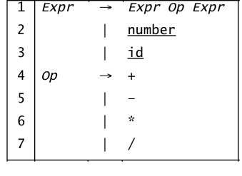
Example CFG
Context-free grammar to describe arithmetic expression
a = x - 2 * y;
Using the expression grammar can we determine if what appears on the right hand side is a valid expression?

Slide 24
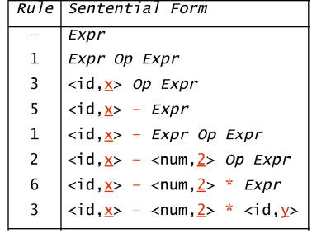
Syntax Checking with CFG
Input: x - 2 * y
We denote this derivation: Expr ⇒* id – num * id

Slide 25
Derivations
A derivation is a sequence of steps
  Starts with the start symbol and ends with a string of terminals
  At each step, we choose a single non-terminal to replace
    These steps are also referred to as re-write steps
    The result of each re-write produces a sentential form
    The final step produces a sentence
      a string in the language
A derivation is usually denoted with ⇒* symbol
Expr ⇒* id – num * id

Slide 26
Derivations
The result of any derivation corresponds to a string in L(G)
What can we say about the relationship about the number of strings in the language and the number of derivations in the grammar?
Der(G) ? | L(G) |

Slide 27
Derivations
The result of any derivation corresponds to a string in L(G)
What can we say about the relationship about the number of strings in the language and the number of derivations in the grammar?
Der(G) ≥ | L(G) |
There can be more than one derivation for the same string!

Slide 28
Derivations
Different choices can lead to different derivations
Two derivations are of interest
  Leftmost derivation — replace leftmost NT at each step
  Rightmost derivation — replace rightmost NT at each step
These are the two systematic derivations
  (We don’t care about randomly-ordered derivations!)
The example we saw was a leftmost derivation
  There is also a rightmost derivation for the expression

Slide 29
Leftmost Derivation

Slide 30
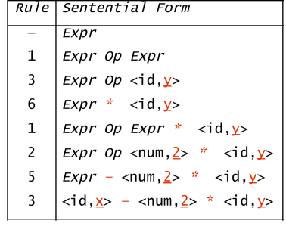
Rightmost Derivation
  Although both leftmost and rightmost derivation say that the expression is legal, the choice of a derivation can cause other problems

Slide 31
Parse Tree
A parse tree or derivation tree is a tree that represents all steps in a derivation
  The root of the tree is the start symbol in the grammar
  Internal nodes are non-terminals
  Leaves are terminals
Constructing a parse tree
  Construct the root node and label it with the start symbol
  For each re-write rule applied
    Create a child node for each terminal and non-terminal in the RHS
      Left to right

Slide 32
Parse Tree
Useful for understanding and verifying derivations
Relatively easy implementation
Forms the basis for operations in future phases
  Semantic Analysis
  Code Generation
Becomes the IR !

Slide 33
Derivations and Parse Trees
Leftmost derivation
G
E
E
Op
E
x
–
E
Op
E
2
*
y
This evaluates as x – ( 2 * y )

Slide 34
Derivations and Parse Trees
Rightmost derivation
G
E
E
Op
E
E
Op
E
*
y
x
–
2
This evaluates as ( x – 2 ) * y

Slide 35
Derivations and Precedence
These two derivations point out a problem with the grammar
  It has no notion of precedence, or implied order of evaluation
To add precedence
  Create a non-terminal for each level of precedence
  Isolate the corresponding part of the grammar
  Force the parser to recognize high precedence subexpressions first
For algebraic expressions
  Multiplication and division, first (level one)
  Subtraction and addition, next (level two)

Slide 36
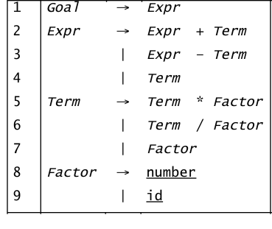
Derivations and Precedence
Adding the standard algebraic precedence produces:
This grammar is slightly larger
  Takes more rewriting to reach some of the terminal symbols
  Encodes expected precedence
  Produces same parse tree under leftmost & rightmost derivations
Let’s see how it parses
x - 2 * y
level
two
level
one

Slide 37
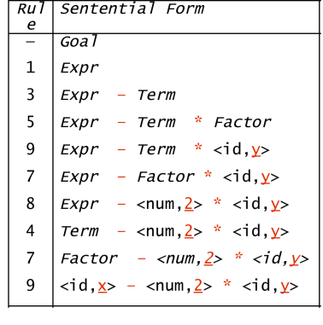
Derivations and Precedence
G
E
E
–
T
T
T
*
F
F
F
<id,y>
<id,x>
<num,2>
Its parse tree
The rightmost derivation

Slide 38
Derivations and Precedence
How does adding precedence change the language?
  It doesn’t!
One example of the parser adding meaning to the sentences
We can manipulate a CFG to incorporate precedence rules
Cannot do this with REs !

Slide 39
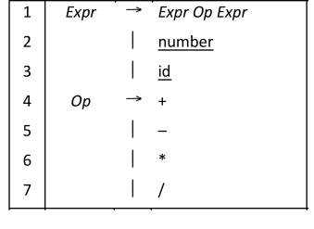
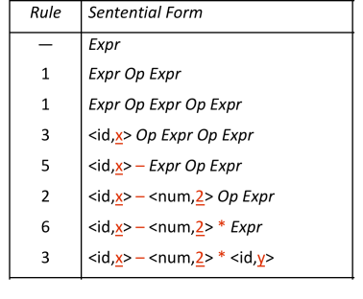
Another Derivation

Slide 40
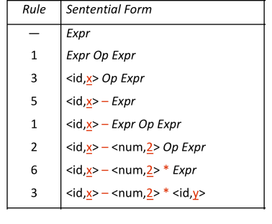
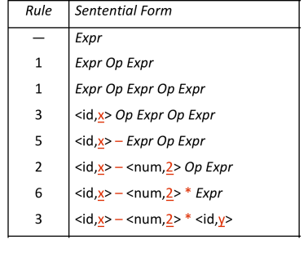
Two Leftmost Derivations for x – 2 * y
Original choice
New choice

Slide 41
Multiple Leftmost Derivations
Having multiple leftmost (or rightmost) derivation is a problem
Why?
  Implies non-determinism
  Difficult to automate

Slide 42
Ambiguous Grammar
If a grammar has more than one leftmost derivation for a single sentential form, the grammar is ambiguous
If a grammar has more than one rightmost derivation for a single sentential form, the grammar is ambiguous
The leftmost and rightmost derivations for a sentential form may differ, even in an unambiguous grammar

Slide 43
The Dangling else
Classic example
Stmt → if Expr then Stmt
  | if Expr then Stmt else Stmt
  | … other stmts …

Slide 44
Ambiguity : Derivations
Input: if E1 then if E2 then S1 else S2
First derivation
    stmt
    2 if expr then stmt else stmt
    1 if expr then if expr then stmt else stmt
    if E1 then if E2 then S1 else S2
Second derivation
    stmt
    1 if expr then stmt
    2 if expr then if expr then stmt else stmt
    if E1 then if E2 then S1 else S2

Slide 45
Ambiguity : Parse Trees
Input: if E1 then if E2 then S1 else S2
if
if
E₁
then
else
E₁
then
if
S₂
if
E₂
then
E₂
then
else
S₁
S₁
S₂
production 2, then production 1
production 1, then production 2

Slide 46
Resolving The Dangling Else Problem
Match else to the innermost unmatched if
      Stmt → if Expr then Stmt
        | if Expr then WithElse else Stmt
        | … other stmts …
      WithElse → if Expr then WithElse else WithElse
        | … other stmts …
Once into WithElse we cannot generate an unmatched else

Slide 47
Deeper Ambiguity
Ambiguity usually refers to confusion in the CFG
Overloading can create deeper ambiguity
  a = f(17)
In many languages, f could be either a function or a subscripted variable
Disambiguating this one requires context
  Need values of declarations
  Really an issue of type, not context-free syntax
  Requires an extra-grammatical solution (not in CFG)
  Must handle these with a different mechanism
    Step outside grammar rather than use a more complex grammar

Slide 48
Ambiguity - the Final Word
Ambiguity arises from two distinct sources
  Confusion in the context-free syntax (if-then-else)
  Confusion that requires context to resolve (overloading)
Resolving ambiguity
  To remove context-free ambiguity, rewrite the grammar
  To handle context-sensitive ambiguity takes cooperation
    Knowledge of declarations, types, …
    Accept a superset of L(G) & check it by other means
    This is a language design problem
Sometimes, the compiler writer accepts an ambiguous grammar
    Parsing techniques that “do the right thing”
    i.e., always select the same derivation

